Slide 1

REQUIREMENTS ANALYSIS
GROUP 22

Slide 2
OUTLINE
Introduction
Tools and Methods for Requirements Analysis
Categorizing Requirements
Prioritizing Requirements
External Interface Requirements
Validation of Requirements

Slide 3
1. INTRODUCTION
In the requirements analysis phase the project team works closely with stakeholders to gather, document, and analyze the needs and expectations for the software system to be developed.
By the end of this phase, the project team will be clear on what to focus on during the development and what our system sets out to achieve.

Slide 4

2. TOOLS AND METHODS FOR ANALYSIS
In this step, we set out to find insights into the key techniques and tools used in requirement analysis, equipping readers with the knowledge needed to effectively navigate this crucial aspect of project management.

Slide 5

I. GOOGLE FORMS
Having played a crucial role in the data collection
Phase, it contain a power engine for analytics, where
We utilized it to gain valuable insights on patern trends,
Priorities and user anxieties.

Slide 6
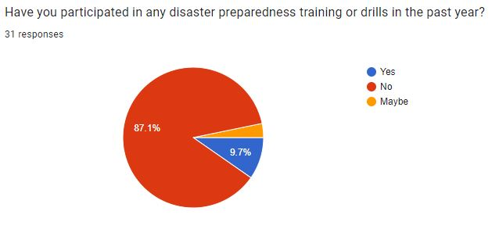
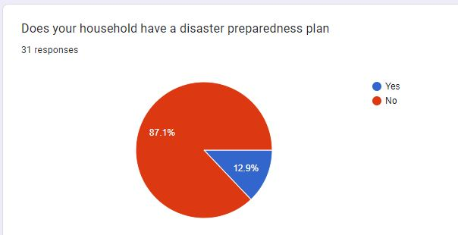

Slide 7
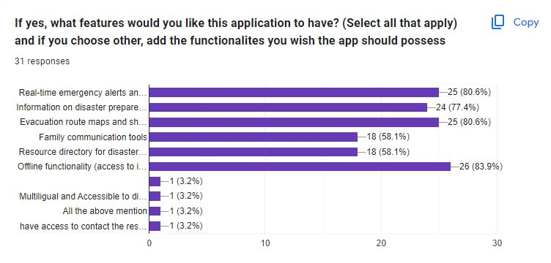

Slide 8
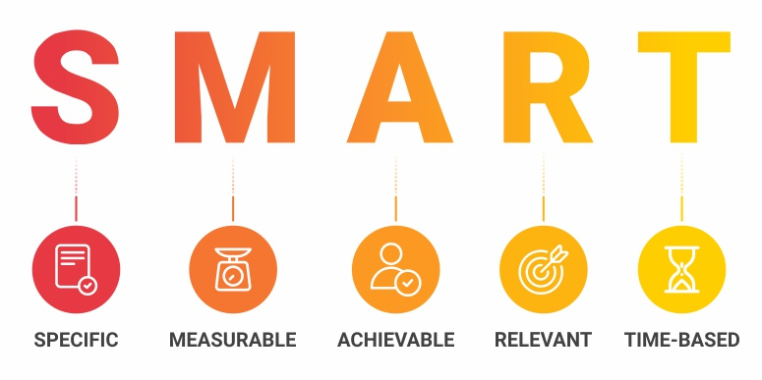
II. REQUIREMENTS EVALUATION
Here, the project team brainstormed and used the SMART analysis approach to assess whether or not a requirement was to be considered in the development of the system.

Slide 9
SMART ANALYSIS
Specific: clear, concise, and well-defined
Measurable: quantified or measured
Attainable: is feasible within the project's constraints
Relevant: does it directly contribute to project objectives
Time-Bound: has a set timeframe for achieving the requirement.

Slide 10
Example of Performing SMART Analysis
Request Help:
Specific: Allow users to request assistance.
Measurable: Track help requests.
Achievable: Implement a help button or chat feature.
Relevant: Essential for user safety and resource allocation.
Time-Bound: Available in the before deployment.

Slide 11
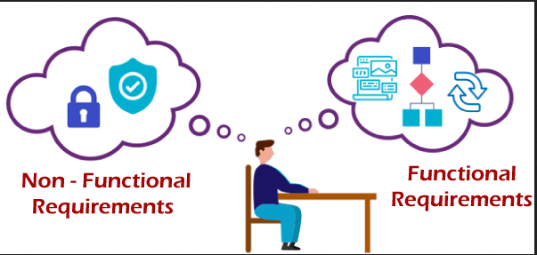
3. CATEGORIZING REQUIREMENTS
After gathering our various requirements, we classified them into functional and non-functional requirements.

Slide 12
FUNCTIONAL REQUIREMENTS
User Registration and Authentication
Real-Time Alerts and Notifications
Incident Reporting
Emergency Resource Access
Community Engagement Features & Communication with Authorities
Geospatial Data Integration and Mapping Services
Request Help
Offline Functionality
Multilingual Support

Slide 13
NON-FUNCTIONAL REQUIREMENTS
Usability
Performance
Security
Reliability
Scalability
Maintainability
Accessibility
Interoperability

Slide 14
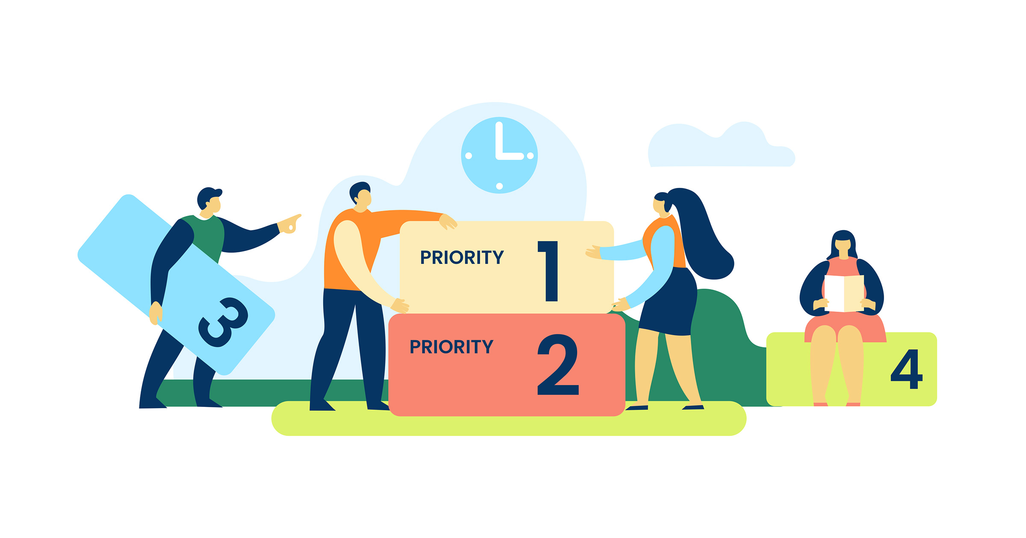
4. PRIORITIZING REQUIREMENTS

Slide 15
High Impact
Real-Time Alerts and Notifications
Incident Reporting
Communication with Authorities
Geospatial Data Integration
Offline Functionality
Moderate Impact
Multifunctional Mobile Application
Community Engagement and Collaboration Features
Evacuation Routes
User Feedback and Support
Lower Impact
Multi-language Support

Slide 16
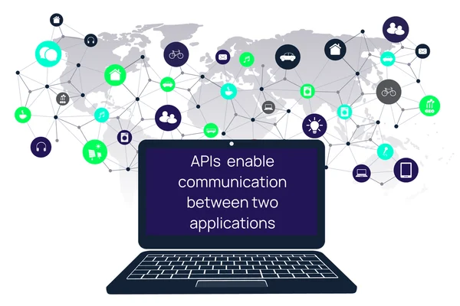
EXTERNAL INTERFACE REQUIREMENTS
BUILDING BRIDGES: External interfaces for collaboration

Slide 17

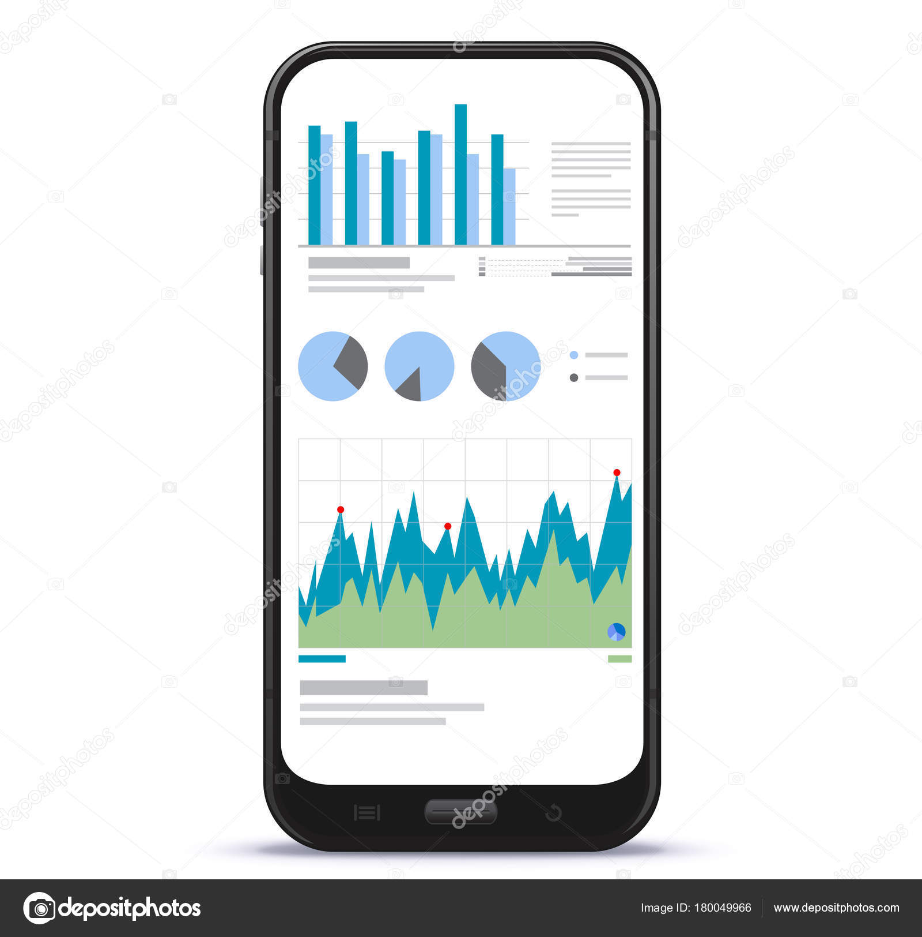
User Interfaces (UI)
Users
Emergency responders /admins

Slide 18
HARDWARE INTERFACES
The application should be accessible from a wide range of standard mobile devices with internet connectivity. This includes smartphones and tablets with various operating systems like Android, iOS, etc. The application should adapt to different screen sizes and resolutions to ensure optimal user experience across various devices.

Slide 19

SOFTWARE INTERFACES
Geospatial Data and Mapping Services: Integration with services like Google Maps or OpenStreetMap allows displaying real-time information about disaster zones, evacuation routes, and shelter locations on interactive maps.

Slide 20
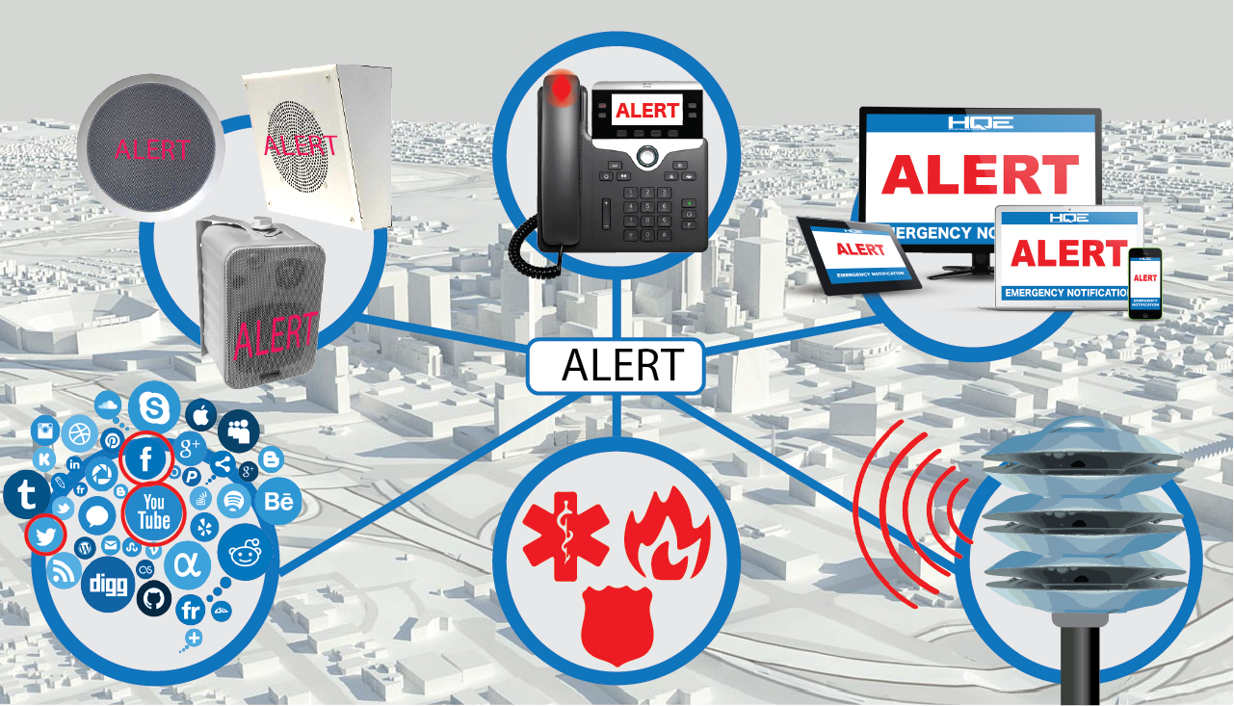
ALERT NOTIFICATION SYSEMS
Alert Notification Systems: The application might interface with existing emergency alert notification systems to receive and disseminate critical information like weather warnings and evacuation orders

Slide 21
Data Management Systems: Integration with government databases or disaster management agency systems could facilitate the exchange of information on resource availability, volunteer registration, and damage assessments.
Social Media Platforms: Integration with social media platforms can enhance community engagement by allowing users to share information and updates during disasters. However, this integration should be implemented with strict data privacy considerations.

Slide 22
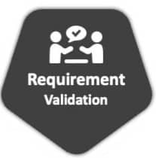
5. VALIDATION OF REQUIREMENTS
Through rigorous validation, we ensure we are building the correct system, as opposed to simply building a system correctly.

Slide 23
Requirements Validation Checks
Completeness Check
Consistency Check
Validity Check
Realism Check
Ambiguity Check

Slide 24
Requirements Validation Techniques
Reviewing the Requirements
Stakeholder Feedback
Use Cases
Test Case Generation
Walkthrough

Slide 25
THE END!!!

